Slide 1
ASIS Academy
Automation by Scripting
Adam Shackleton

Slide 2
Course Agenda
1. Introduction to Python
- What is scripting; Why Python; Lighting Python lesson
2. Introduction to Automation
- What do we mean by automation; Interacting with files and the file system
3. APIs
- What’s an API; How to access them using Python
4. Databases
- Lighting SQL lesson; Creating and using database connections
5. Excel Files
- Pandas; Common Excel functions in Python

Slide 3
Today’s Agenda
Python tasks
Review of last week’s content
Dictionaries
Third party libraries
Introduction to APIs
HTTP Requests
More Python tasks
Using the requests library to access data
Authentication to APIs
Further reading
Code challenge
Notes:
If you have questions throughout please put them in the chat and if anyone knows the answer they’re welcome to help me out, otherwise I’ll sweep them up before we go into the exercises
This isn’t a Python course – it’s a course about using python so the pace might be a bit fast – rest assured all the code I show as examples will be available when you’re working on the exercises

Slide 4


Tools we’ll use during our sessions
Python 3.10
VS Code
https://www.python.org/
https://code.visualstudio.com/
Notes:
This presentation and all the code I show is in the github repo I’ve shared in the chat

Slide 5
Last week recap

Slide 6


Python - Dictionaries
Dictionaries are arrays of data that have key: value pairs
The values (or keys) in a dictionary can be any data type, integer, a list, or even another dictionary
The entries in a dictionary are accessed using their key
If you loop over a dictionary, you will get the key by default

Slide 7
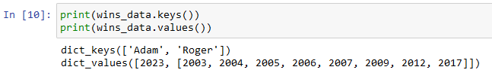
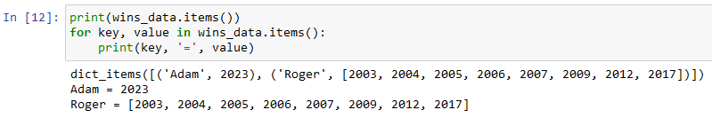
Python - Dictionaries
You can access either the keys or the values as lists using .keys() or .values()
You can also use .items() get a tuple of both keys and values
We will rely on dictionaries heavily for the remainder of these sessions, so it’s worth getting acquainted with them
Notes:
dict_keys is not an actual list, you may need to cast it to a list to use some list features
list(x)

Slide 8
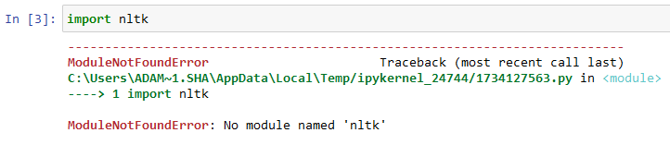
Python – Third party libraries
Last week we talked about accessing the additional functions that come with Python in the Standard Library, but that is only scratching the surface of the features available in Python
There are a huge number of additional functions implemented in libraries that have been built by “the community”, which could be individuals or companies, and are available for free.
The are many ways to access these, but by far the most common is through the Python Package Index or PyPI
These libraries are included in your Python code just the same way as standard libraries
But first you have to download and install them…

Slide 9
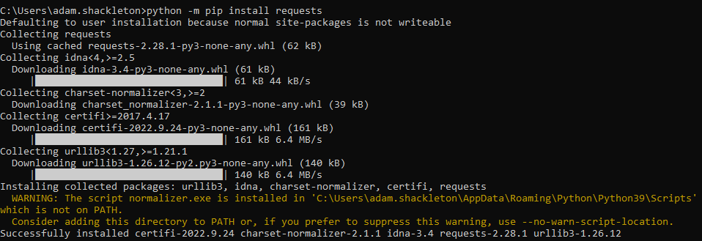
Python – Third party libraries
To install a third party library from PyPi, we use the package installer called pip – this comes with python. It is used from the command line using the command pip install and the library name
(you might be able to use pip without the python –m bit, it depends on how you installed python, but this way should always work)
j
pip will download and install any dependencies at the same time

Slide 10

What is an API?
Application Programming Interfaces are a code-based way for computers to interact with each other
Whenever two applications are talking to each other over the internet, there’s good chance they’re using APIs
Many applications or services have an accessible API that we can write scripts to interact with

Slide 11
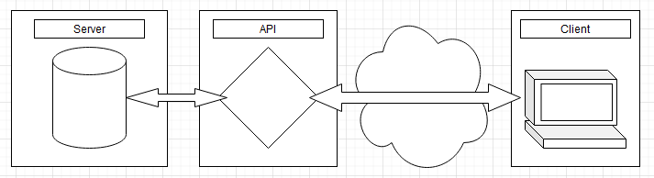
What is an API?
Notes:
API layer creates an abstraction on the database
Makes getting or pushing data into a “feature” with a specific endpoint for a specific use case
Means that connections are over standard web channels and can be secured like websites, don’t require giving database access or opening additional firewall ports
If you want to know more about building APIs, they were covered in the Lab Data Integration ASIS Academy course
https://connectedlearning.accenture.com/learningboard/1092978-asis-academy-cloud-transformational

Slide 12
HTTP Requests
APIs use HTTP requests to pull and update data.
HTTP requests are messages sent to initiate some action on the server.
They have a “verb” such as GET, POST, DELETE which describes the action they are intended to perform.
They have and headers section and a body section (although the body section is not always used).
The headers section contains information about the content which helps the applications involved understand how to interpret it, e.g. the Date, the Content-Type, the Client type.
The body section contains the content to be shared. This could be the client passing information to update on the server in a POST request, or the server passing back the requesting information for a GET request.

Slide 13
Making an API request
First – read the documentation (I know)
https://www.genenames.org/help/rest/
Assemble your request, for GET requests there are three components to think about:
URL
URL Parameters
Headers
For other request types you may also need to identify the body content to send

Slide 14
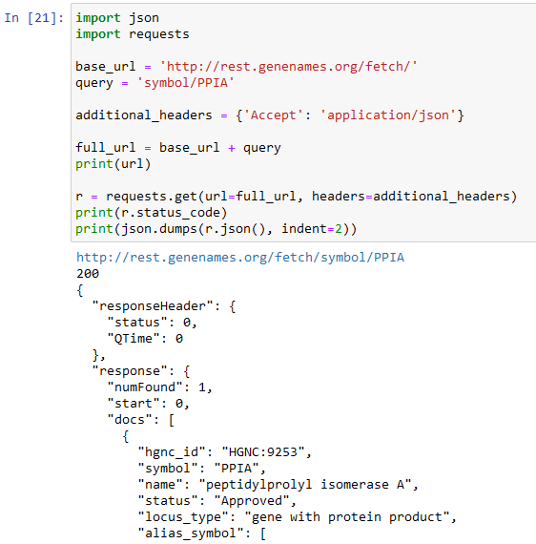
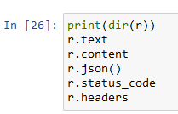
Making an API request
In this example all the logic is contained in the URL
The API has two mode of return json or xml, so we specify which we want in an Accept header
We can use the requests library to call the API with a GET request
Once complete, we can interrogate the response using class attributes / methods
Notes:
Status Codes
2xx is successful
4xx is client error
5xx is server error

Slide 15
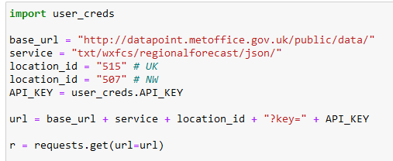
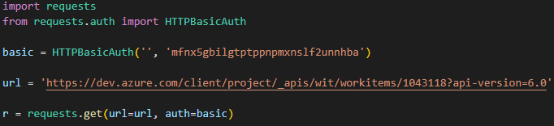
API authentication
APIs that access data which is in anyway restricted typically require the service accessing them to be authenticated.
Typically this is done by either encoding a username and password in the request or by using an API token which you apply for separately.
Usually the authentication is sent in the request headers, but sometimes in the URL parameters
Notes:
Generally not a good idea to send credentials in URLs as they can be snooped on

Slide 16
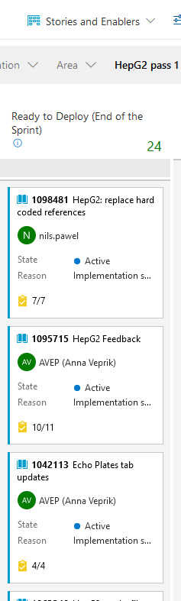
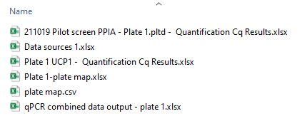
Real life examples

Slide 17
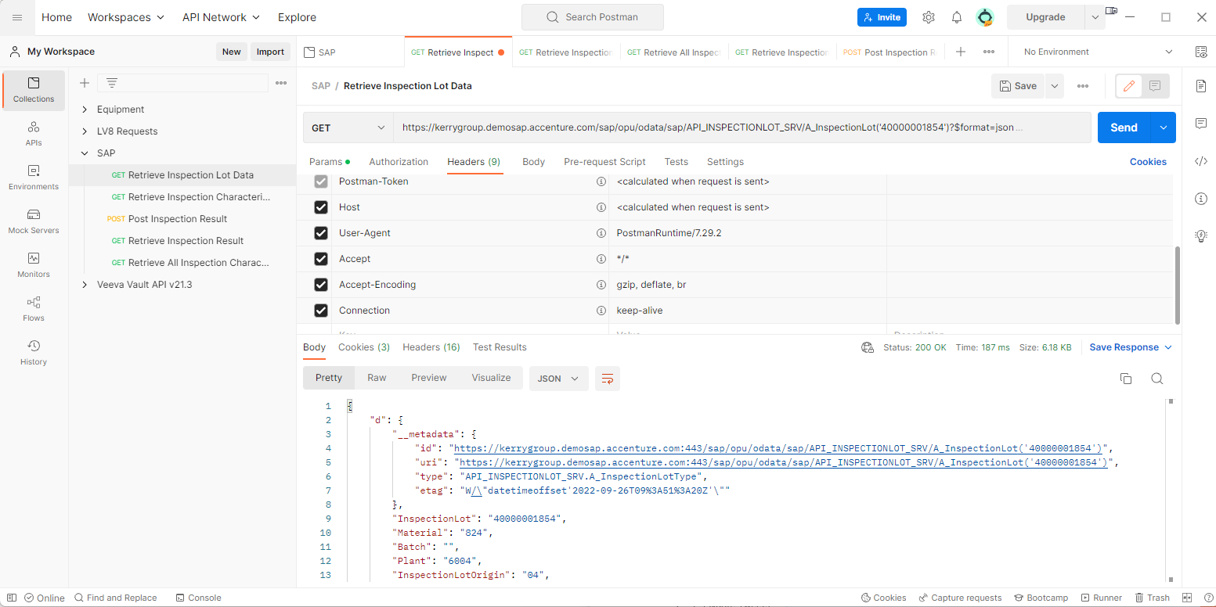
Further reading – useful tools
For setting up access to APIs and generally getting used to how they work and what data will be returned, I highly recommend Postman
https://www.postman.com/downloads/

Slide 18
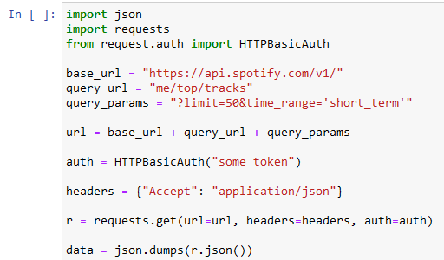
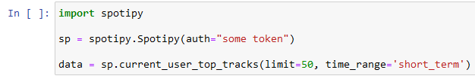
Further reading - SDKs
Sometimes, people or organisations create a language-specific library which makes using their API easier, this is typically called a Software Development Kit – SDK
When looking at writing scripts to access an application’s API, it’s worth checking if they have a Python SDK first, as this should hopefully make your work easier
For example Spotify has an SDK called spotipy which makes common requests into dedicated functions

Slide 19
Thank You

Slide 20
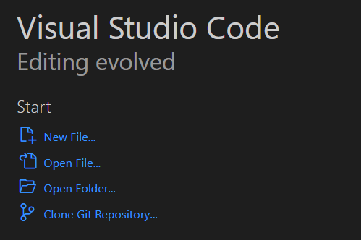
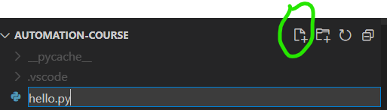
Checking it’s working – Hello World
Once Python and VS Code are installed, create a folder to hold your code and then open VS Code
When it opens, click Open Folder… and select your desired location
From the Explorer, click the new file icon and call it hello.py

Slide 21
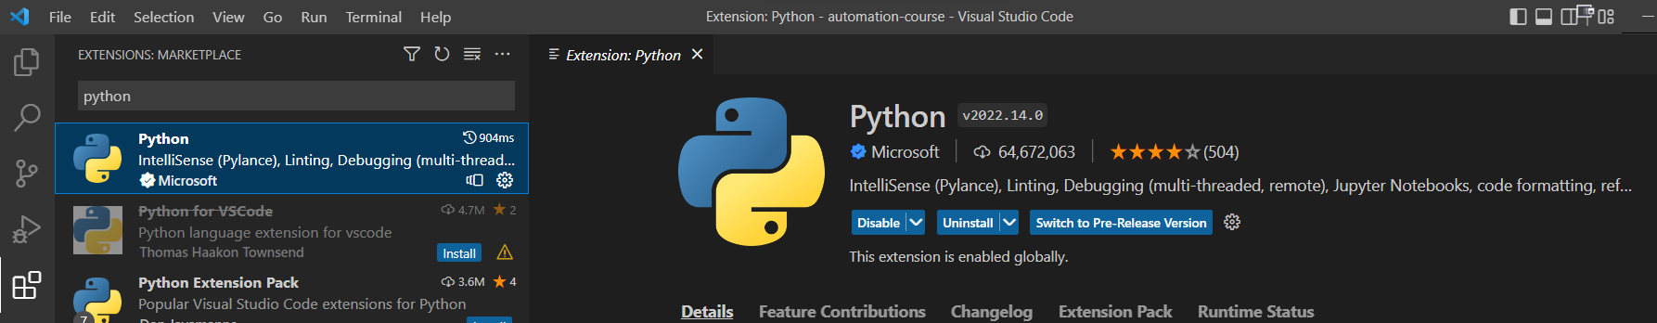
Checking it’s working – Hello World
There’s a good chance VS Code will recognise that you are running a python file and ask you to install the python extension, if not, go to the Extensions icon and search for it
Click the blue install button (shows as “Uninstall” in my screenshot)

Slide 22
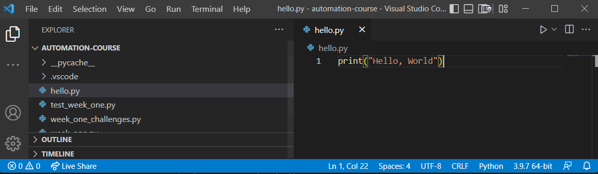
Checking it’s working – Hello World
Once that’s done, go to your hello.py file and type print(“Hello, World”)
Check that VS Code has recognised you have a Python interpreter, shown here as 3.9.7, and click the play button in the top right corner

